Slide 1
Association between Consumption of Artificial Sweeteners and Breast Cancer Risk: A Systematic Review and Meta-Analysis of Observational Studies
in the name of God
Nutrition and Cancer, 75:3
Journal club- 8/4/2023
Presentation by: Maede mousavi

Slide 2
introduction
Its incidence is rising
5th leading cause of cancer mortality
Significance of breast cancer
In 2020 incidence of breast cancer> lung cancer
Leading cause of global cancer incidence
Accounts for :
1 in every 4 cases of cancer
1 in every 6 cancer death in women
♀
Sung H, Ferlay J, Siegel RL, Laversanne M, Soerjomataram I, Jemal A, Bray F. Global cancer statistics 2020: GLOBOCAN estimates of incidence and mortality worldwide for 36 cancers in 185 countries. CA A Cancer J Clin. 2021;71(3):209–49. doi: 10.3322/caac.21660

Slide 3
introduction
Breast feeding
Reducing alcohol consumption
Preventing obesity
Factors that likely reduce the
risk of breast cancer incidence
McTiernan A, Porter P, Potter JD. Breast cancer prevention in countries with diverse resources. Cancer. 2008;113(S8):2325–30. doi: 10.1002/cncr.23829

Slide 4
introduction
Artificial sweetener :a substance that can be added to foods and beverages in place of sugar
Examples: saccharin, aspartame, cyclamate, and acesulfame potassium
High sugar intake
DM-type2
Encouraging calorie intake
obesity
BC risk factors
2012;346:e7492–e7492. doi: 10.1136/bmj.e7492 7. Calle EE, Kaaks R. Overweight, obesity and cancer: epidemiological evidence and proposed mechanisms. Nat Rev Cancer. 2004;4(8):579–91. doi: 10.1038/nrc1408 8. Giovannucci E, Harlan DM, Archer MC, Bergenstal RM, Gapstur SM, Habel LA, Pollak M, Regensteiner JG, Yee D. Diabetes and cancer: a consensus report. Diabetes Care. 2010;33(7):1674–85. doi: 10.2337/dc10-0666 9. Elliott SS, Keim NL, Stern JS, Teff K, Havel PJ. Fructose, weight gain, and the insulin resistance syndrome. Am J Clin Nutr. 2002;76(5):911–22

Slide 5
introduction
Opposing results of different studies
artificial sweeteners
reduce energy consumption
maintain weight
promote weight loss
artificial sweeteners
No weight reduction
Vos MB, Kaar JL, Welsh JA, Van Horn LV, Feig DI, Anderson CA, Patel MJ, Cruz Munos J, Krebs NF, Xanthakos SA, et al. Added sugars and cardiovascular disease risk in children: A scientific statement from the American Heart Association. Circulation. 2017;135(19):e1017–e1034. doi: 10.1161/CIR.00000000 00000439 16. Mooradian AD, Smith M, Tokuda M. The role of artificial and natural sweeteners in reducing the consumption of table sugar: A narrative review. Clin Nutr ESPEN. 2017;18:1–8. doi: 10.1016/j.clnesp.2017.01.004

Slide 6
introduction
An Italian study from 2007: the incidence of BC is negatively correlated with the intake of artificial sweeteners
a French study in 2022 consumers of total artificial sweeteners, were associated with an increased risk of BC
Gallus S, Scotti L, Negri E, Talamini R, Franceschi S, Montella M, Giacosa A, Dal Maso L, La Vecchia C. Artificial sweeteners and cancer risk in a network of case-control studies. Ann Oncol. 2007;18(1):40–4. doi: 10.1093/annonc/mdl346Debras C, Chazelas E, Srour B, Druesne-Pecollo N, Esseddik Y, Szabo de Edelenyi F, Agaësse C, De Sa A, Lutchia R, Gigandet S, et al. Artificial sweeteners and cancer risk: Results from the NutriNet-Santé population-based cohort study. PLoS Med. 2022;19(3):e1003950. doi: 10.1371/journal.pmed.1003950

Slide 7
introduction
Up to now:
no systematic review on the relationship
between artificial sweeteners and the risk of BC
Aim of this study: analyzing and synthesizing the data on these substances and BC.

Slide 8
methods
participants without BC (cohort study) at the time of recruitment or previous history of BC (case-control study).
The exposed group was exposed to any type or dose of artificial sweeteners, and the non-exposed group was not exposed to artificial sweeteners.
Inclusion criteria
The incidence of BC was taken as the result.
The study is a case-control, prospective or retrospective cohort study.

Slide 9
A schematic flow for the selection of articles included in this meta-analysis

Slide 10
methods
one study each was conducted in these countries, Denmark, Italy, Australia, America, and France.
The time of the experiment :1984 to 2021, and the articles were published between 1990 and 2022.
The exposure assessment: questionnaire or interview.
The cohort studies were conducted in MCCS, NHS, NHSII and NutriNet-Santé
enrolled 314,056 participants in total, of which 13,304 suffered from the BC.
In case-control studies, they included 4,043 cancer cases and 3,910 controls.
the recruitment age: 18 to 70 and the median follow-up time: 7.8 to 11.6
Age adjustment: in every analysis,
the remaining: place of residence, SEIFA, smoking, alcohol drinking, physical activity, BMI, total energy intake, consumption of hot beverages, family history of BC, etc
The quality of all the studies were assessed using the Newcastle-Ottawa Scale

Slide 11
methods
Low dose group :1-3 time/month
High dose group:<7 times/week
Classification of exposure group:
middle-dose group :
>1 time/week &
<7 times/week
The intake of non-exposure group or very-low-dose group was < once a month

Slide 12
results
5 studies were included in the systematic review, 2 case-control studies and three cohort studies.
Artificial Sweeteners and Risk of Breast Cancer: In this mate-analysis, the participant exposed to artificial sweeteners had no different incidence of BC from the non-exposure group (OR = 0.98, 95%CI = [0.94-1.03], p = 0.450)

Slide 13
results Forest diagram of artificial sweeteners exposure and breast cancer incidence (p=0.450)

Slide 14
Results separation of the study based on dosage
The low and middle dose groups were included in two cohort studies
the high-dose group was included in three studies, which were two cohort studies and one case-control study respectively
Subgroup analysis: compared with the non-exposure/very-low-dose group, the incidence of BC had no difference in the population exposed to low-dose artificial sweeteners
(OR = 1.01, 95%CI = [0.95-1.07], p = 0.831)

Slide 15
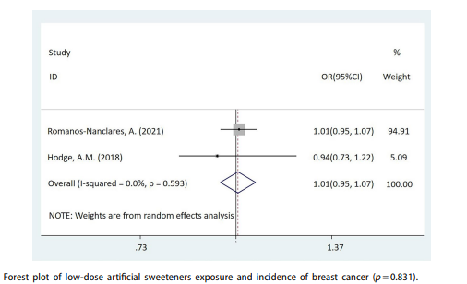
results

Slide 16
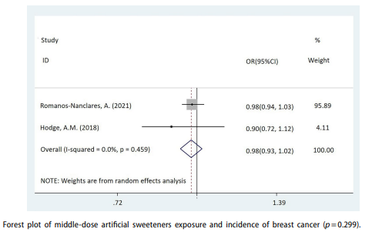
results
In the middle-dose group: no difference in the incidence of BC between the exposed and the non-exposed/very-low-dose group (OR = 0.98, 95%CI = [0.93-1.02], p = 0.299)

Slide 17
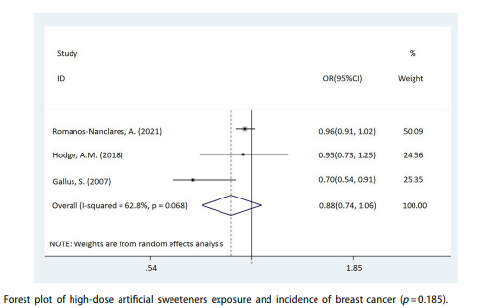
results
Compared with the non-exposure/very-low-dose group, the incidence of BC also had no difference in the population exposed to high-dose artificial sweeteners (OR = 0.88, 95%CI = [0.74-1.06], p = 0.185)

Slide 18
discussion
there was no statistical significance link between artificial sweeteners and BC. Furthermore,
the results of subgroup analysis: no relationship between the exposure dose and the prevalence of BC.

Slide 19
discussion
Artificial sweeteners are calorie-free
reduce sugar consumption lower insulin and satiety
Help reducing weight
Lower the risk of DM-2 when compared to sucrose
desserts, sweets, and diets high in refined sugar may increase the risk of BC in women
The relevant mechanisms of sweetness and obesity: insulin resistance, hyperinsulinemia, increased bioavailability of steroid hormones, oxidative stress, and inflammation
oberts DL, Dive C, Renehan AG. Biological mechanisms linking obesity and cancer risk: new perspectives. Annu Rev Med. 2010;61(1):301–16. doi: 10.1146/ annurev.med.080708.082713

Slide 20
discussion
these metabolic alterations produce a setting that favors the development and spread of malignancies.
High sugar consumption independently induce chronic activation of the insulin signaling system and elevation of indicators of oxidative stress and inflammation, which together raise the risk of BC
obesity does not significantly increase the incidence of BC in premenopausal women
postmenopausal overweight women have higher chance of developing the disease than slim women
Klement RJ, Kämmerer U. Is there a role for carbohydrate restriction in the treatment and prevention of cancer? Nutr Metab (Lond). 2011;8(1):75. doi: 10.1186/1743-7075-8-75Sparano JA, Wang M, Zhao F, Stearns V, Martino S, Ligibel JA, Perez EA, Saphner T, Wolff AC, Sledge GW, et al. Obesity at diagnosis is associated with inferior outcomes in hormone receptor-positive operable breast cancer. Cancer. 2012;118(23):5937–46. doi: 10.1002/cncr.27527

Slide 21
discussion
the risk of BC in patients with type 2 diabetes increased by 23%
there is a positive correlation between type 2 diabetes and the incidence rate of BC during the 10-year follow-up
De Bruijn KMJ, Arends LR, Hansen BE, Leeflang S, Ruiter R, van Eijck CHJ. Systematic review and meta-analysis of the association between diabetes mellitus and incidence and mortality in breast and colorectal cancer. Br J Surg. 2013;100(11):1421–9. doi: 10.1002/bjs.9229

Slide 22
Discussion molecular point of view
Different subtypes of BC based on hormone expression
Estrogen receptor
Progesterone receptor
Human epidermal growth factor-2 receptor (HER-2)
-HER-2 and hyperglycemia and insulin resistance (IR) have been shown to be linked
-DM-2 patients higher circulating HER-2 concentrations
-the normal levels of insulin-link growth factor-1 (IGF-1) and insulin-link growth factor-2 (IGF-2) in overweight people as well as the rise in insulin levels may cause an over-activation of the IR and IGF-1R pathways. Because the signal transduction mediated by IR/ IGF-1R will further boost HER-2 synthesis, encourage cancer cell proliferation and spread, and hinder cancer

Slide 23
Discussion molecular point of view
Adipose tissue primary source of estrogen synthesis after menopause obesity raise the risk of BC in postmenopausal women
Obesity caused by high glucose more adipose tissue estrogen-sensitive breast tissue will receive more estrogen stimulation, while estradiol (E2) stimulates cell growth through the role of estrogen receptor replication errors during mitosis and mutations

Slide 24
Derived from the these mechanisms, artificial sweeteners seem to reduce the incidence of BC
This research results show that there is no relationship between artificial sweeteners and BC.
no artificial sweetener has been consistently linked to negative health consequences, and according to FDA inspection

Slide 25
Discussion
the carcinogenic risk of artificial sweeteners is still debatable
certain of its by-products, such as formaldehyde, a by-product of aspartame metabolism, are known carcinogens.
Formaldehyde is a high-risk factor for triggering BC
it can break down the BRCA2 protein, a tumor suppressor protein.
Artificial sweeteners and the risk of BC have conflicting findings. Most studies showed no association, but some studies showed that the risk was reduced

Slide 26
Aspartame and potassium acetylsulfate were the two specific artificial sweeteners that were linked to an increased risk of BC
But with no statistically significant relationship between the total amount of artificial sweeteners and BC risk
Bucher Della Torre S, Keller A, Laure Depeyre J, Kruseman M. Sugar-sweetened beverages and obesity risk in children and adolescents: A systematic analysis on how methodological quality may influence conclusions. J Acad Nutr Diet. 2016;116(4):638–59. doi: 10.1016/j.jand.2015.05.02

Slide 27
conclusion
there is no relationship between the exposure of artificial sweeteners and the incidence of BC.
due to the limitation of this study, more large-scale studies are needed to further explore

